Slide 1

Company Overview
November, 2021
2

Slide 2
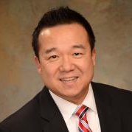
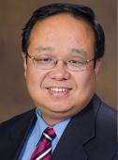
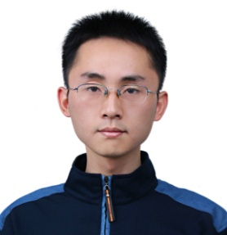







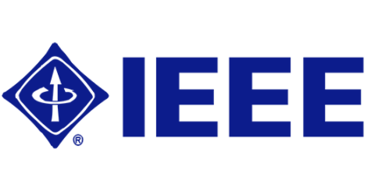
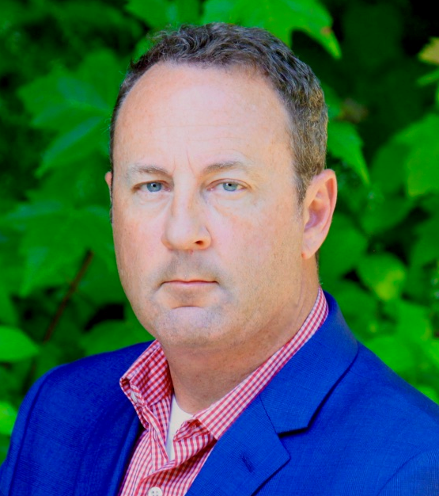

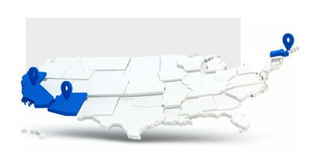






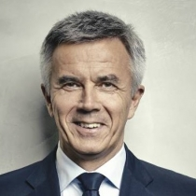

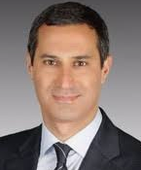
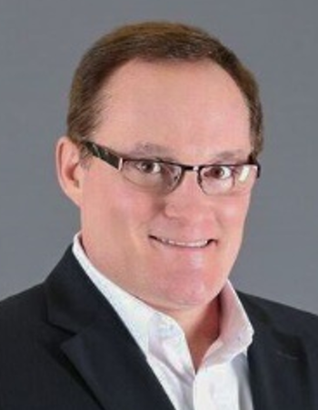
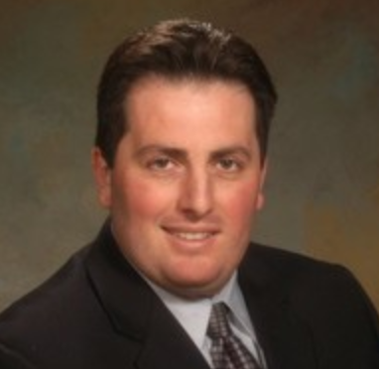
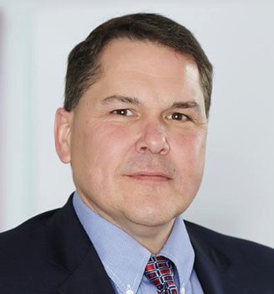


Our Team.
Lunewave’s business team has deep partnership experience in the auto industry while the technical team is led by world-class radar engineers
John Xin
CEO
Co-Founder
Hao Xin
CTO
Co-founder
Min Liang
VP, Product Tech
Co-founder
Rob Bingle
VP, Product Engineering
Julia Schlueter
Head of Ops/HR
Headquarter: Tucson, AZ
Lunewave Board
Byron McCormick
30+ yrs. GM Executive
Peter Schwarzenbauer
30+ yrs. BMW,
VW (Porsche/Audi)
Executive / Board Member
James Zizelman
25+ yrs. APTIV, Stoneridge Executive
Vahe Tazian
15+ yrs. FORD, APTIV, Harman AV/Mobility/Tech Transactions
John Moloney
30+ yrs. Bosch, Bose, Executive
Chris Capone
President, LMG
25+ yrs. Executive
Ed Pease
Partner, Mintz
25+ yrs. M&A & Legal
Peter Smith
CEO of Edgewise
Entrepreneur
3

Slide 3
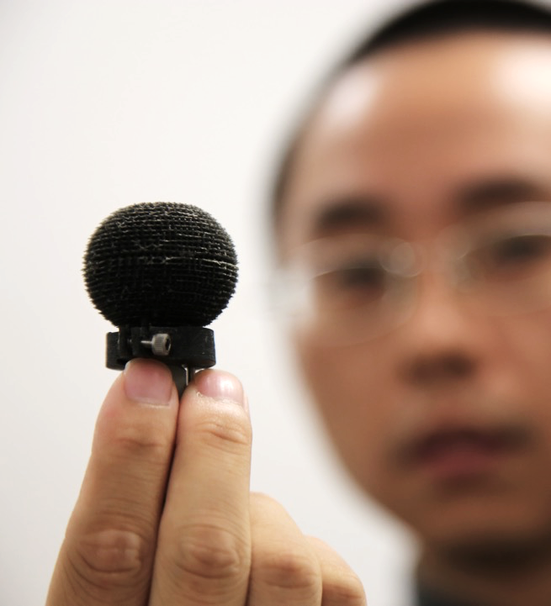
Disruptive technology.
Luneburg lens’ spherical symmetry and uniform aperture size enables consistent high performance across entire 4π solid angle
Broadband behavior
High Gain
Ability to form multiple beams
No scan angle limit
4

Slide 4



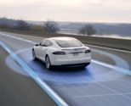


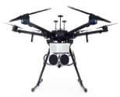

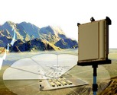
  Lunewave’s core technology has applications across a broad set of industries
Luneburg Antenna + Algorithms
Enable system-level solutions across multiple industries:
    Object Detection 2) Information Transfer
1
2
Automotive | 5G | Construction/Mining/Agriculture | Drones | Robotics | Security
5

Slide 5
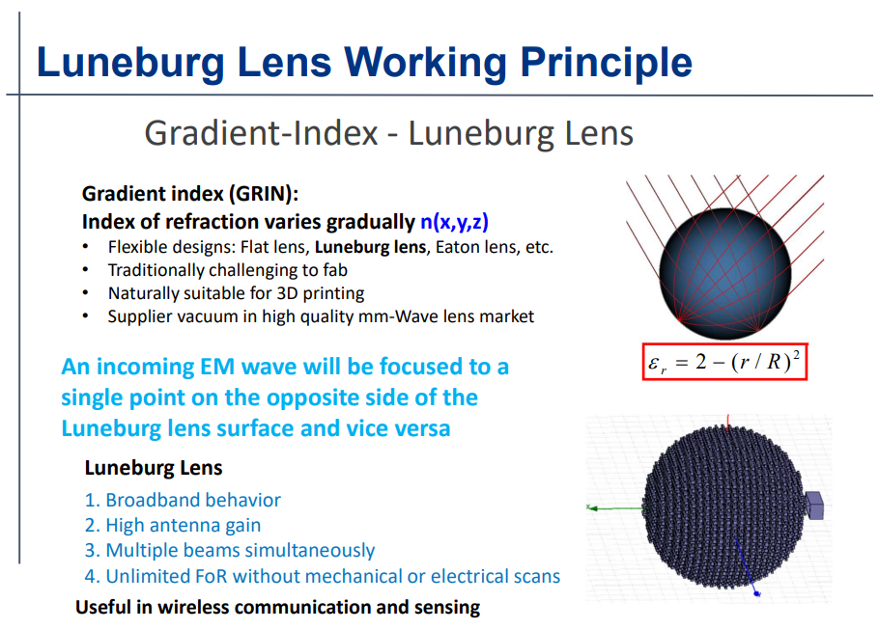
6

Slide 6
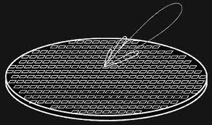
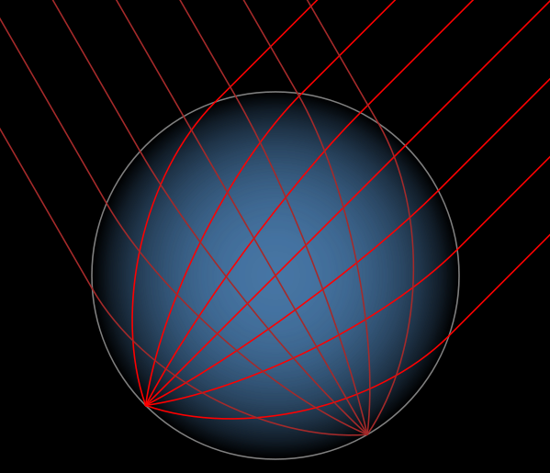
Luneburg Lens Based System - No Scan Angle Limit
Planar Phased Array
Luneburg Lens
VS
Scan angle coverage limit ~ 90-120 degree due to the aperture efficiency
Deformation of the beam when scanning to different angle
Lower signal to noise ratio
Low frequency agility
Spherical symmetric
Aperture size from any direction is the same
No scan angle limit for Luneburg lens phased array
7
7

Slide 7
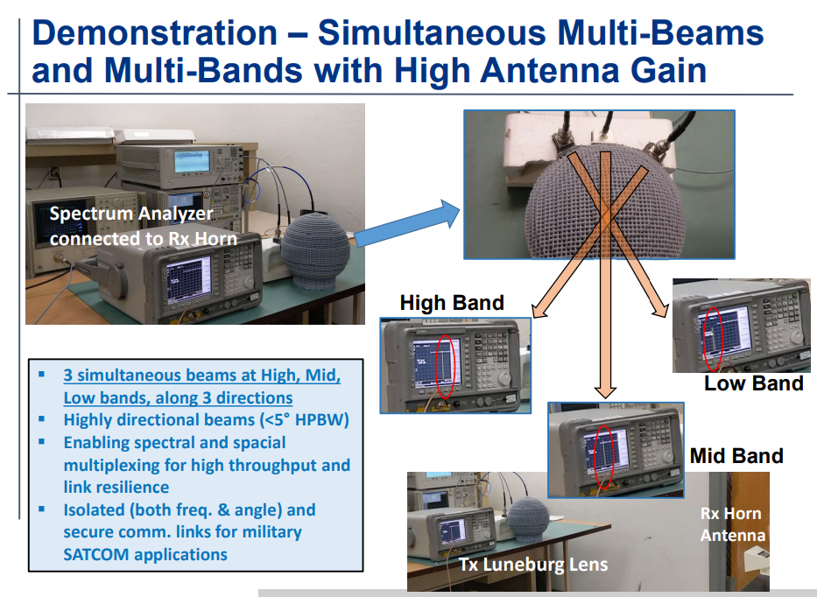
8

Slide 8
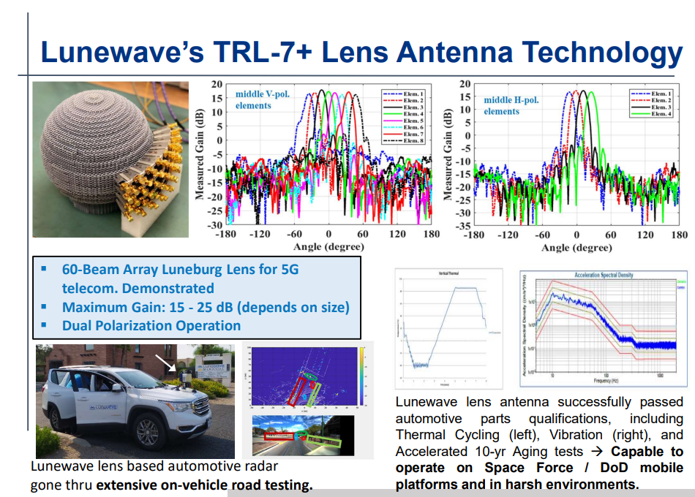
9

Slide 9
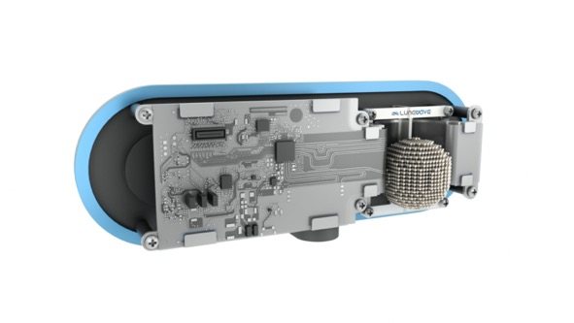
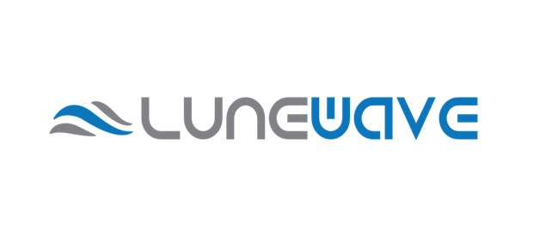
Thank you.
John Xin
Email: JOHN@LUNEWAVE.COM
Phone: (617) 991-8492
Redefining Automotive Sensing
10

