Slide 1
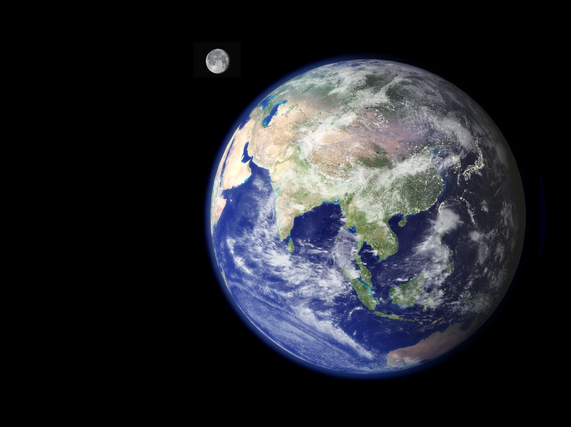

MIT INTERNATIONAL SCIENCE
AND TECHNOLOGY INITIATIVES
PIONEERS IN INTERNATIONAL EDUCATION

Slide 2

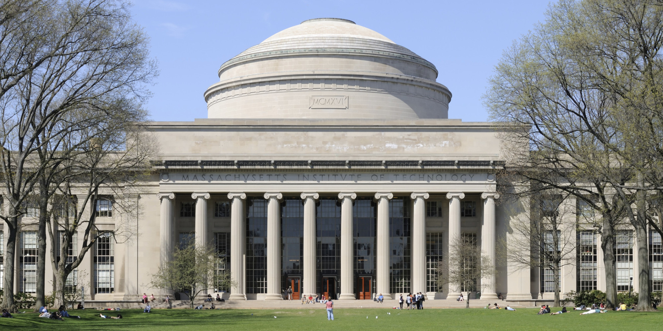
MASSACHUSETTS INSTITUTE OF TECHNOLOGY

Slide 3


Slide 4

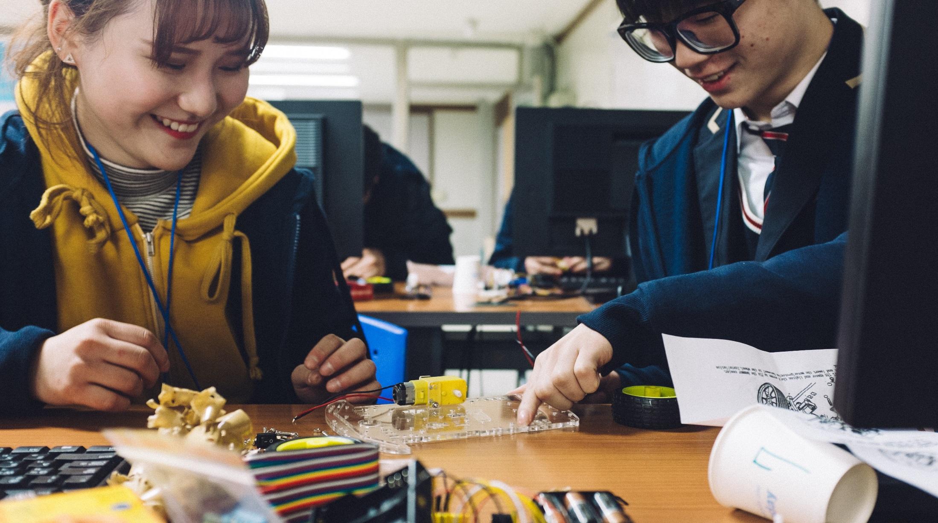
MIT INTERNATIONAL SCIENCE
AND TECHNOLOGY INITIATIVES

Slide 5

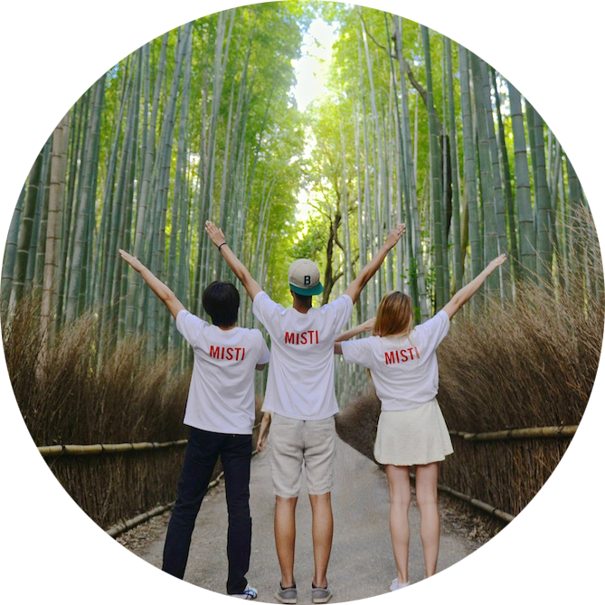
MISTI INTERNSHIP PROGRAM
MISTI's pioneering internship program matches MIT students with projects in companies and labs around the world.

Slide 6
MISTI INTERNSHIP PROGRAM
How is MISTI unique?
MIT’s Mens et Manus ethos
Location-specific programs
Students are well prepared
The MIT students

Slide 7
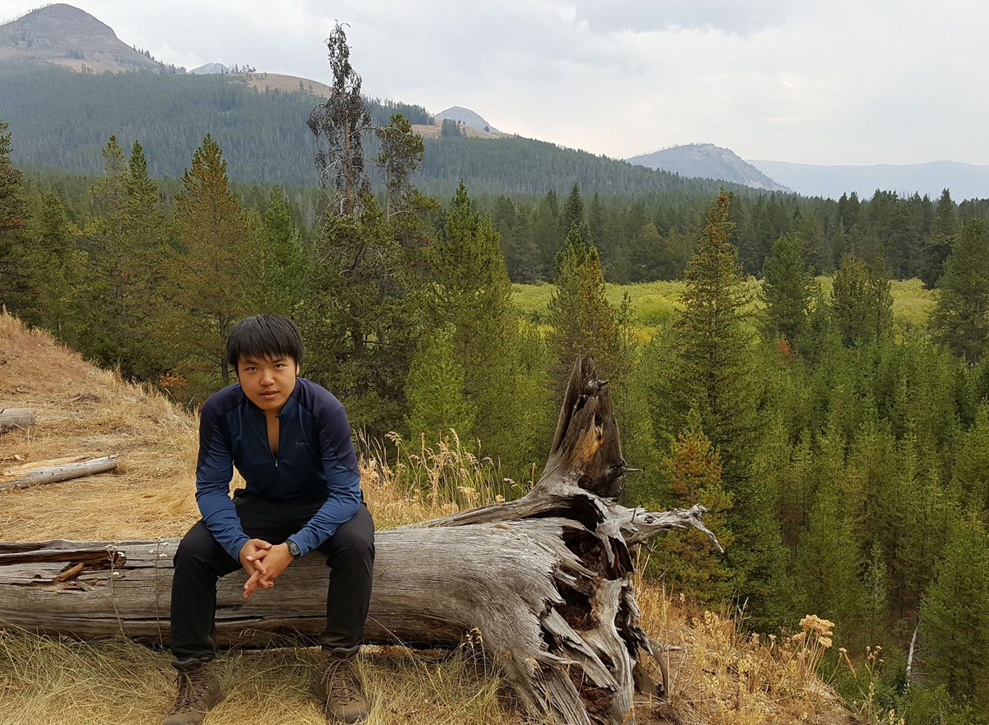
Ji Seok Kim, Samsung Electronics in Korea
Computer Science and Engineering, 2019
MIT-Korea
"To make an impact as one of many teams within a multinational company collaborating to promote and protect a single product – that was empowering and highly educational."
Used data science and machine learning techniques to explore and analyze datasets
to maintain product quality and a positive customer experience. Ji Seok gathered
intelligent conclusions from physical and social data at disposal at the Samsung
Electronics Headquarters in Suwon, Korea.

Slide 8
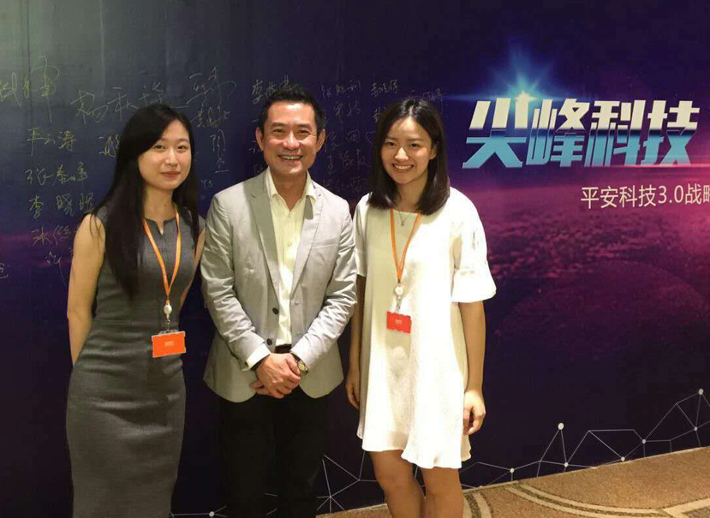
Celia Han, Ping An Technology in China
MIT-China
Computer Science, 2019
“I thoroughly enjoyed my
MISTI experience in China. It strengthened my determination to gain more knowledge in machine learning and it has impacted my future career plans significantly. I got the chance to experience what it is like to work in tech at a finance firm, and also got to experience navigating the workplace in China.”
Collaborated with MIT CSAIL and developed an automatic speech
recognition model using CNTK and Kaldi at Ping An Technology in China.

Slide 9
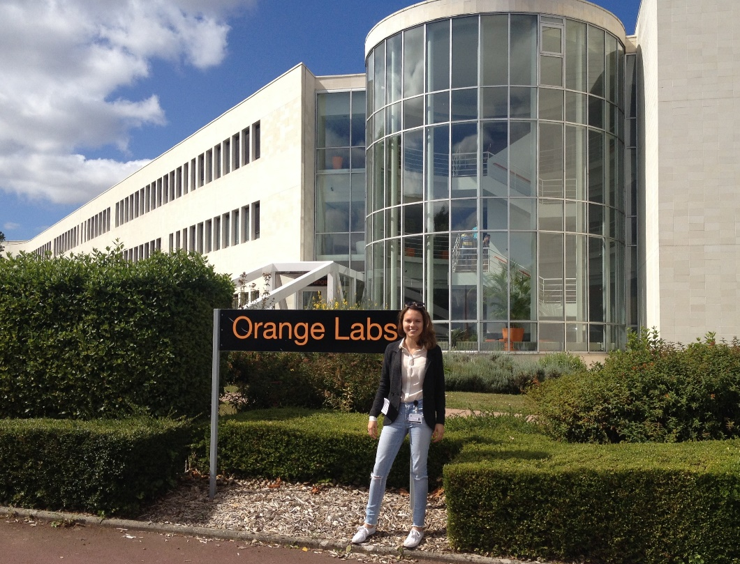
Marie Menshova, Orange Labs R&D in France
MIT-France
Electrical Engineering & Computer Science, 2017
“My summer internship through MISTI on privacy at Orange Labs,
a large telecommunications company, expanded my knowledge of security standards in other countries and contributed to a successful completion of my MIT research project in the same field with a paper to be published
this year.”
Designed an algorithm that would anonymize a given dataset with sensitive
information, proposing solutions and performing mathematical analysis to solve the
issue telecommunication companies have when it comes to collecting information
about their clients for research purposes.

Slide 10
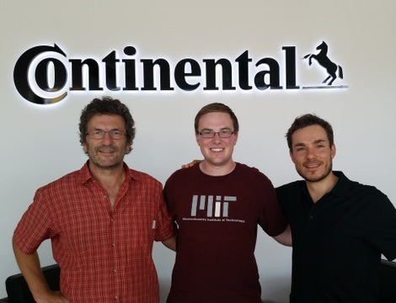
Michael McGraw, Continental Corporation in Germany
Computer Science and Engineering, 2017
MIT-Germany
“Traveling opens new doors and experiences that are unimaginable unless you have traveled. Experiencing lands, food, culture, and people will show you more than you could ever read or watch. My work experience benefited myself and the company tremendously – both their expectations and my
own were exceeded.”
As the Body and Security intern, worked on Continental internal tooling solutions,
developed several Java plug-ins, and bundled these into an Eclipse feature that will be
used in their sites around the world for AUTomotive Open System ARchitecture.
Produced Schema validation program within AUTOSAR.

Slide 11
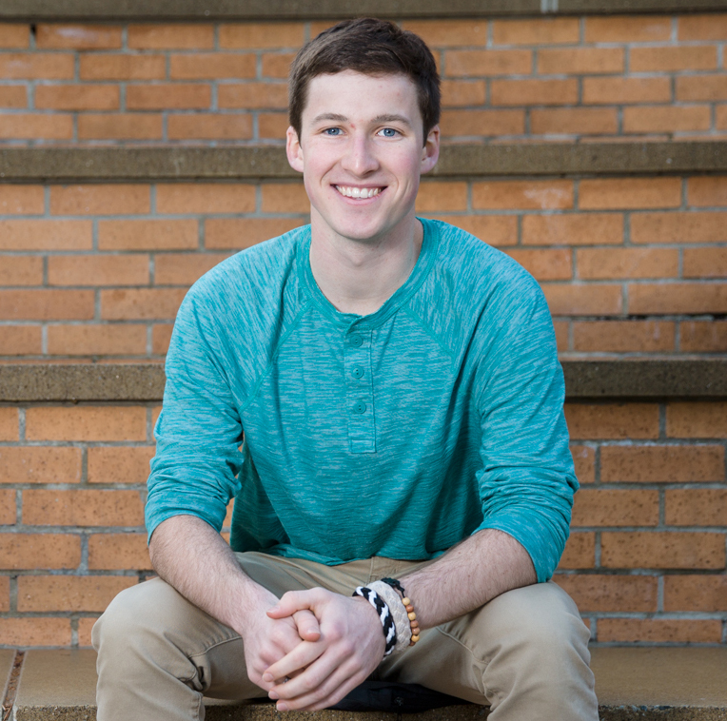
Evan Denmark, Infosys Ltd. in India
MIT-India
Computer Science and Engineering, 2017
"MISTI has taught me how to design, develop, and execute a project on a global scale, something I never thought I could have done."
Developed a machine learning computer vision tool
to read text on blurry photos at Infosys Ltd. In Bangalore, India.

Slide 12
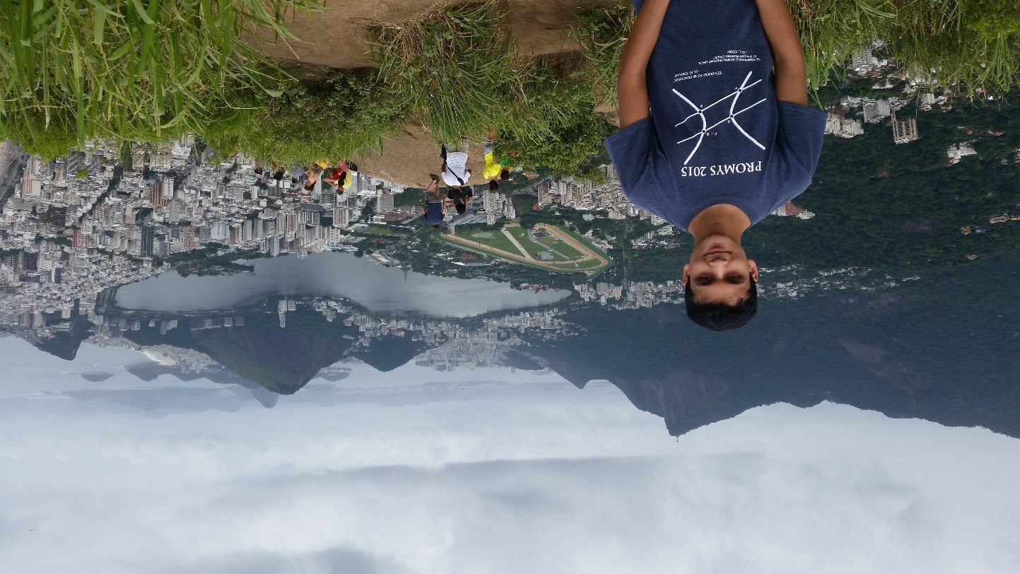
Arjun Khandelwal, B2W Digital in Brazil
MIT-Brazil
Mathematics, 2019
"The experience I had at B2W not only gave me the opportunity to experience a vibrant, different culture firsthand, but also prepared me thoroughly for future
work environments."
Used machine learning techniques and qualitative studies to develop a new
"buybox" algorithm for the leading e-commerce company in Brazil.

Slide 13
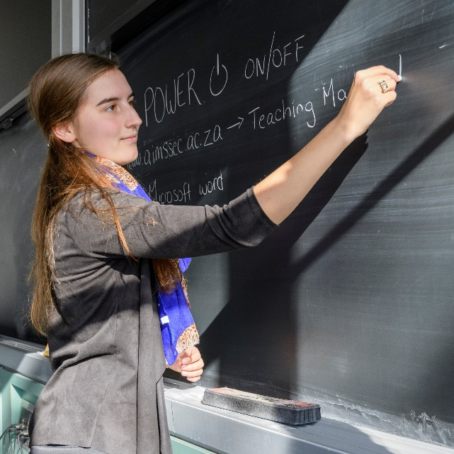
MISTI INTERNSHIP PROGRAM
How does it work?
You tell us what you need
We work with our students to find possible matches
You select students
We work with you on logistics
You cover costs
Most internships happen in summer
Open to all students
We send nearly 1,000 students every year

Slide 14
MIT INTERNATIONAL SCIENCE
AND TECHNOLOGY INITIATIVES
CONTACT US
MISTI.MIT.EDU
MISTI@MIT.EDU

Slide 15
AT MIT, WE EDUCATE OUR STUDENTS TO TAKE ON THE WORLD’S GREAT CHALLENGES FOR THE BETTERMENT OF HUMANKIND. WHAT BETTER PREPARATION THAN FOR
THEM TO EXPLORE THE WORLD, CONFRONT ITS CHALLENGES AND EXPERIENCE ITS HUMANITY THROUGH MISTI?
- MIT President L. Rafael Reif

